Slide 1
Calcified Blood vessel
Sponsored by W.L. Gore and Associates
Team: Michael Rickerd, Nolan Kirk, Bryce Ribucan, Cameron Fisher, Skyler Buchanan, Kathryn Shallcross

Slide 2
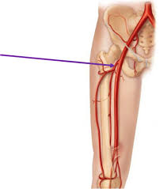
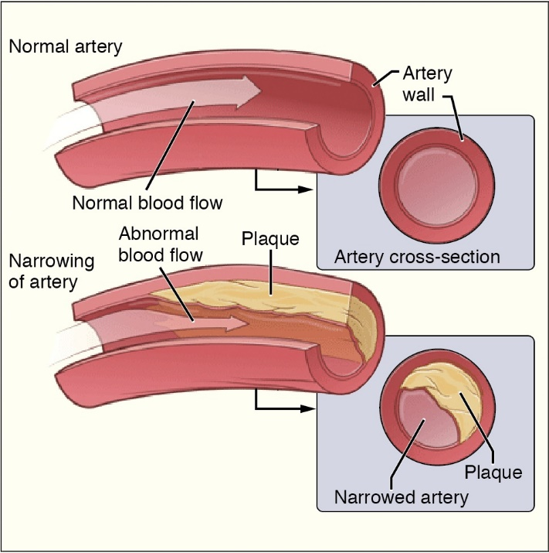
Project Description
Project Overview: Tasked with replicating a diseased portion of the femoral artery for the testing of various medical devices
Healthy/diseased arteries [2]
Femoral artery [1]
Notes:
Mike:
“This project is centered on replicating the diseased state of the femoral artery. This means that we will be focusing on accurately recreating the occlusion (which is the calcified buildup within the artery) without the use of biological materials. On the left you can see a picture which indicates the location of the femoral artery in the leg of a human being. This is the area of study for this project. The occlusions that form in the femoral artery are not the same as the occlusions that form elsewhere in the body. On the right you see an image that depicts a healthy artery with normal blood flow compared against the cross sectional area of a diseased artery. The yellowish portion of the right picture, labeled ‘plaque’, is the part of this system that our group is working to recreate.”
Purpose of slide:
Provide a high-quality labeled image of your current manufactured design.

Slide 3
Project description
Client: W.L. Gore & Associates
One primary areas of focus:
  Replicating the calcified buildup
    Emphasis on replicating femoral artery has been reduced
More narrow focus: Single lesion style and a statistical analysis of calcified buildup properties
Notes:
Mike:
“The client for this project is W.L. Gore & Associates. This design is important to them because they want to have the ability to study the deployment of their various medical devices in more realistic situations.
There will be one primary area of focus for this project. The focus revolves around replicating the calcified buildup. This task is more important to the final design because it is the part of the project that hasn’t been engineered and studied by many individuals or companies. Replicating the artificial femoral artery will be accomplished through the use of off-the-shelf tubing, which will be provided by W.L. Gore & Associates. This decision will allow for a more thorough analysis, testing, and replication of the calcified buildup. Through meetings with the mentorship team at W.L. Gore & Associates, our focus has been narrowed to a single reproducible occlusion, with a heavier emphasis placed on a thorough statistical analysis of the created specimen.”
Purpose of slide:
Provide a high-quality labeled image of your current manufactured design.

Slide 4
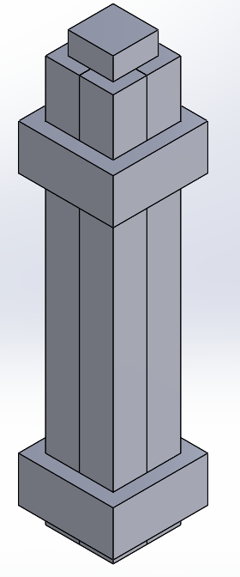
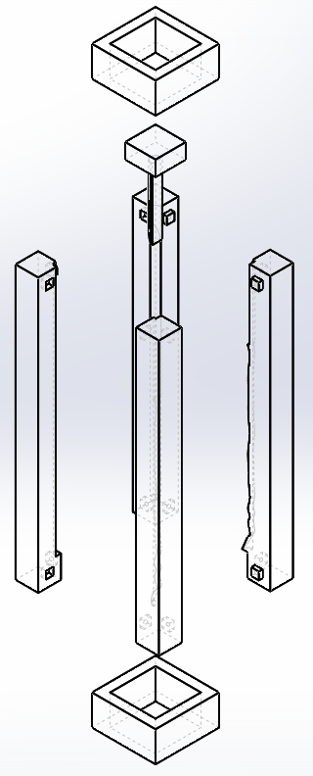
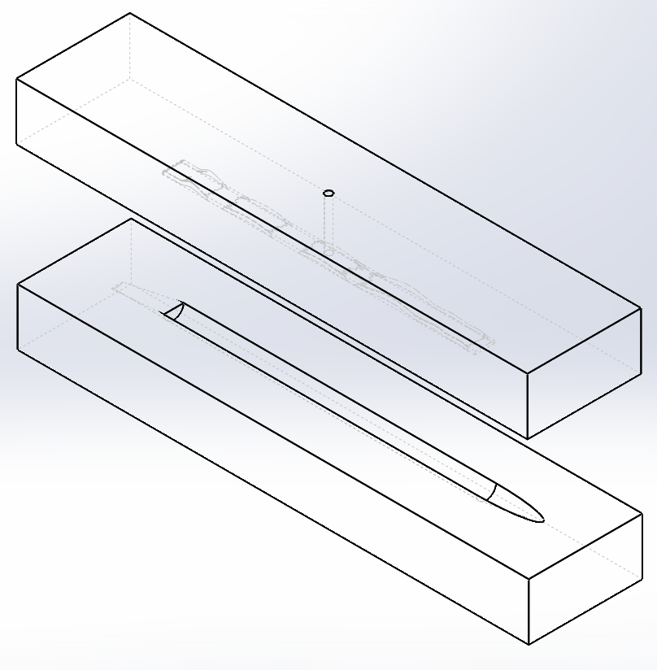
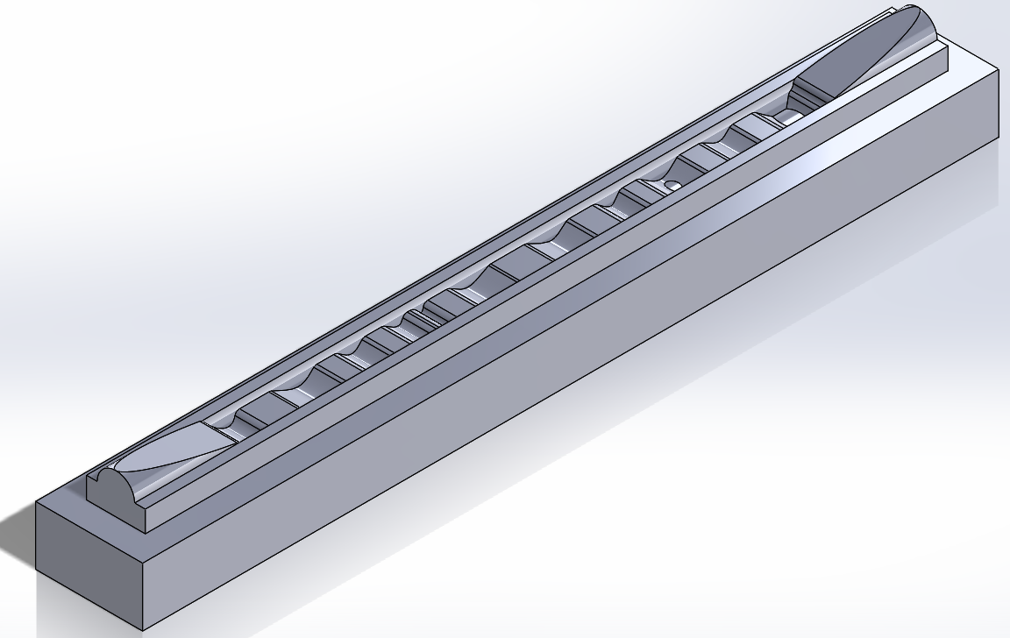
Updates
Material meets all applicable Engineering Requirements
Several Iterations of the mold have been created and tested.
Notes:
Nolan:
“Since the last presentation we have been doing constant prototyping and testing with molds as well as material testing. The material testing resulted in a slightly altered dental stone and water mixture which yielded hardness values in our expected range, a quick manufacturing time and no hazardous danger to the user. The first mold that we tried can be seen here to your left, however the adhesion to the plastic mold was to strong and the calcified lesion didn’t survive extraction from the mold. The molds went through several different testing phases including one which split the lesion vertically rather than horizontally as seen in the first to pictures. Again the greatest problem that the team faced was removing the hardened lesion from the mold. After struggling to remove the lesion from a 2 part mold, the team started to consider a multipart mold. Although this may add some time to assembly, it will greatly increase the success rate of the mold and the ease of lesion extraction. This design is currently in drawing phase, but will be printed and tested on Thursday.”
Purpose of slide:
Update the audience to what has been accomplished since the last presentation. Where there any changes to the design? What caused those changes?

Slide 5
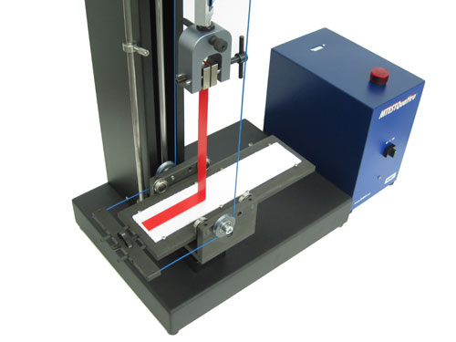
updates
Final Aspects of Design:
  Easily manufactured
    Assembly/Disassembly
    Lesion removal
    Production rate
  Extremely consistent calcifications
    Hardness values
    Constant size
      Occlusion
      Thickness
      Length
Final research and testing will be focused on finding an adhesive material
90 degree peel test [3]
Notes:
Nolan:
“The project is beginning to look finalized, we are confident that the new mold will work much better and finding an acceptable material was a big step. On Thursday the team will be doing a large sample test to prove that the hardness values are constant with our previous findings which Cameron will expand more on. The multi-piece mold should meet all applicable engineering requirements and be an improvement form the current models. This mold needs to be tested and altered if need be to best assist the user. The final aspect of the design that needs to be finished is the adhesion of the lesion to the simulated blood vessel wall. The adhesion strength of the lesion to the vessel will be evaluated using ASTM-D6862. This procedure will pull the vessel at a 90 degree angle relative to the lesion using a tensile force. The strength of the adhesion between the parts will be evaluated based on the force required to separate them.”
Purpose of slide:
What is left in the manufacturing of the design?

Slide 6
Moving forward
Adhesion trials will begin as lesion manufacture continues
ASTM tests to be used for properties
Statistical analysis will be done for 100 models
12 final models will be produced
Significant budget and time availability for any contingencies
Notes:
Cameron:
“As manufacture of lesions for statistical analysis continues, adhesion trials will begin to determine the best method for adhering the lesion to the vessel. ASTM standards will continue to be the basis for material analysis and evaluation. We will produce 100 lesion models for a statistical analysis. After we can assure to our client that all models will meet the requirements we will then produce 12 final models for the client. In case of unforeseen circumstances we have the ability to increase meeting/manufacture time and also have a large portion of our budget remaining.”
Purpose of slide:
Detailed plans of manufacturing (if any manufacturing is still required).
Detailed plans for testing the design.
Contingencies (schedule, budget, etc.) for possible redesigns based on the results of testing.

Slide 7
Moving forward
Occlusion Modeling: Mike, Cameron, Skyler
Adhesion Solutions: Kathryn, Nolan, Bryce
Budgeting: Kathryn
Scheduling: Skyler
Resource Liaison: Bryce
Notes:
Bryce:
“Since the last presentation the team has developed more defined roles within the team. The project deliverable has been divided into two main components one subsection devoted to creating the occlusion which entails material selection and modeling methods. And another subset devoted to adhesion solutions which is working on fitting the occlusion in the silicon tube that simulates our vessel. As of right now Mike Cameron and Skylar are working on the occlusion while Kathryn Nolan and myself will be testing adhesion methods. Budgeting and scheduling are still handled exclusively by Kathryn and Skylar respectively. And I am still the client contact and resource liaison for the team.”
Purpose of slide:
Who is responsible for what?

Slide 8
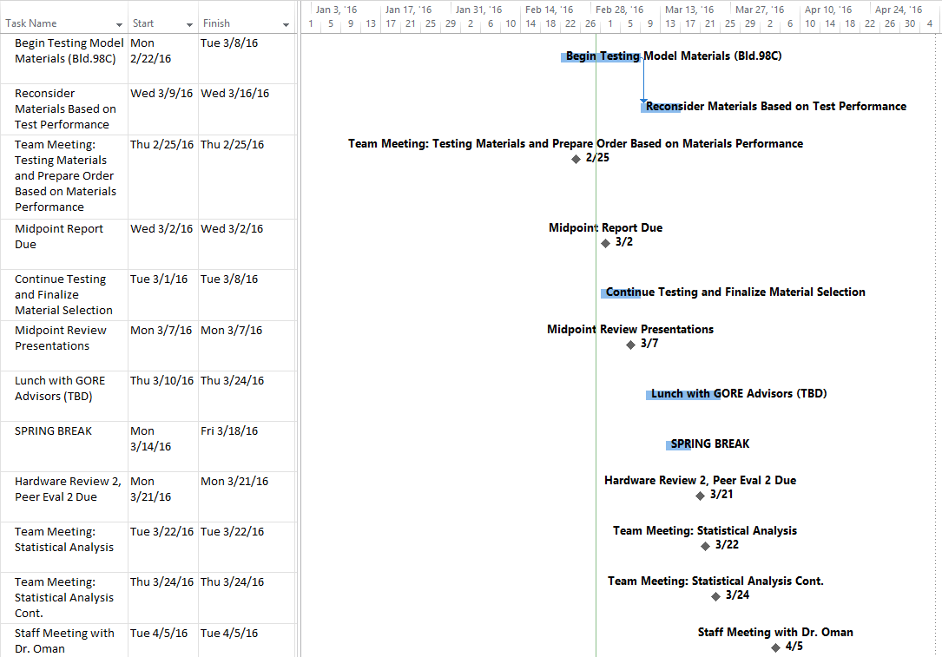
Schedule and budget
The team is currently on schedule to complete all tasks.
Notes:
Skyler:
“Here is a snapshot of our schedule outlining the deadlines to keep us on track to complete the project. As the semester continues and our deadlines become closer the Gantt chart becomes more helpful to ensure we complete all tasks in time. In the next few weeks the team will finalize the manufacturing process for the calcification model including final material selection. After the manufacturing process is finalized the team will begin statistical analysis and prepare the final deliverable including a presentation at WL Gore. The team is currently on schedule to complete all tasks.”
Purpose of slide:
Provide a schedule for this term showing when key tasks still need to be completed. Indicate if you are currently on, ahead, or behind schedule.

Slide 9
Schedule and budget
Overall budget (provided by W.L. Gore): $3,000
Total expenditures to date: $386.06
  Lesion material prototyping materials
  Testing equipment
Total dollars available: $2,613.94
Anticipated expenses:
  Further testing for lesion material properties
  Equipment for mixing lesion materials (scale, graduated cylinder, etc.)
  Not anticipated to cost more than $400
Notes:
Katie:
“Our budget of $3,000 has been provided by W.L. Gore and Associates, and we have successfully made multiple purchase orders that total to just under $400. This money has been spent towards buying multiple ceramics that can be used in our current mold design, all equipment needed to mix them, and equipment for hardness testing. This has left us with about $2,600 left. Our future expenses for testing should not exceed $400 unless we decide to purchase more testing equipment, so our planned expenditures for testing include more lesion ceramic materials, and more mixing equipment so that we can bring the tolerances of our ceramic mixture down as much as possible.”
Purpose of slide:
Describe the project’s budget including total dollars available, anticipated expenses, actual expenses to date, and the resulting balance.

Slide 10
references
[1] Narrowed Artery. [Online] Available: www.nhlbi.nih.gov. [Accessed: 02- Nov- 2015].
[2] Femoral Artery. [Online] Available: www.studyblue.com. [Accessed: 02- Nov- 2015].
[3] Judge Tool, "1090 peel test fixture". [Online]. Available: http://www.judgetool.com/mark-1090peeltestfixture.aspx. [Accessed: 31- Jan- 2016].

Slide 11
Questions?

